Slide 1
PointNet: Deep Learning on Point Sets for 3D Classification and Segmentation
汇报人：逯孝珑
汇报时间：2019.11.5

Slide 2
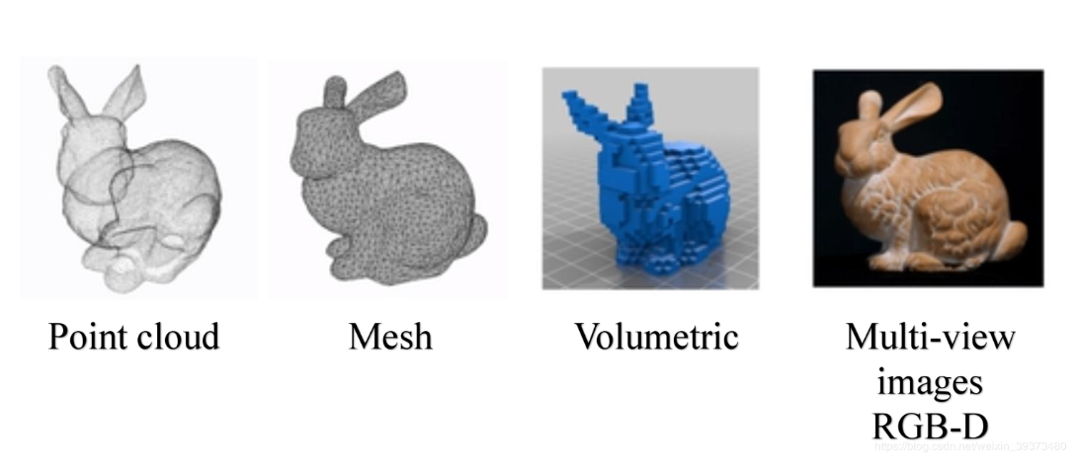
Representation of three-dimensional data
Point cloud
Mesh:It consists of triangular and square slices
Volumetric:The object is represented by 0 and 1 by a 3d grid
Multi-view images RGB-D

Slide 3
Point cloud
Definition
A point cloud is a data set of points in a coordinate system that contains rich information，such as three-dimensional coordinates X, Y, Z, color, strength value, time, and so on.
Acquisition
Most point cloud data is generated by 3D scanning devices, such as LiDAR, RGB cameras. These devices automatically measure information about a large number of points on an object's surface and then output point cloud data with some kind of data file.

Slide 4
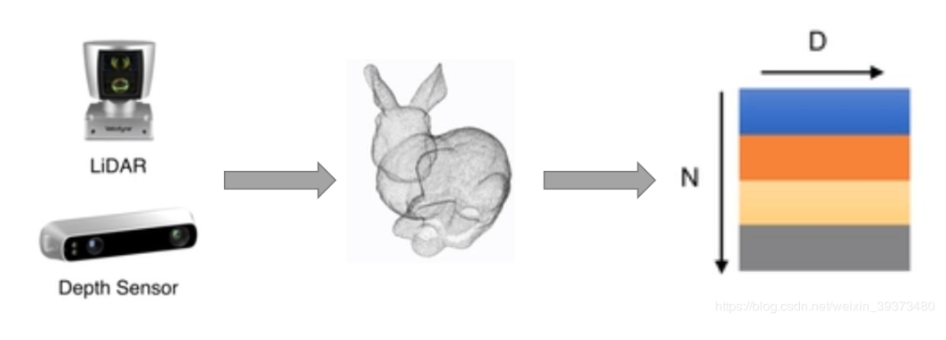

Point cloud
Why
Point cloud is close to raw sensor data
Point cloud is representationally simple，An object is represented only by an N$×$D matrix

Slide 5
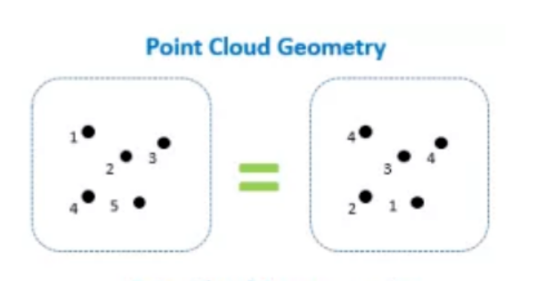
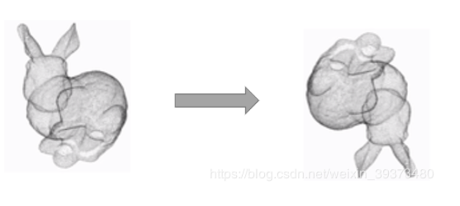
Problem with point cloud
Irregular format
A point cloud is essentially a long series of points, and geometrically, the order of the points does not affect its representation of the overall shape in space.
Rotation invariance
The same point cloud passes through a certain rigid change in space and coordinates change, but it does not affect the overall shape.

Slide 6
The solutions to the problem
Most solutions
Most researchers transform such data to regular 3D voxel grids or collections of images. This, however, renders data unnecessarily voluminous and causes issues.
Highlights of this article
Spatial transformation network solves rotation problem
Symmetric function to solve the disorder problem

Slide 7
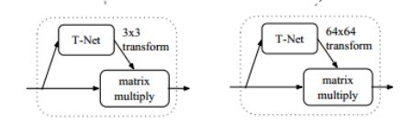
Spatial transformation network (STN)
T-net is a micro-network used to generate a transformation matrix to normalize the rotation, translation, and other changes of the point cloud and the transform/align network is a miniature PointNet.
MaxPooling
3*3
输入点云
MLP
n*1024
MLP

Slide 8
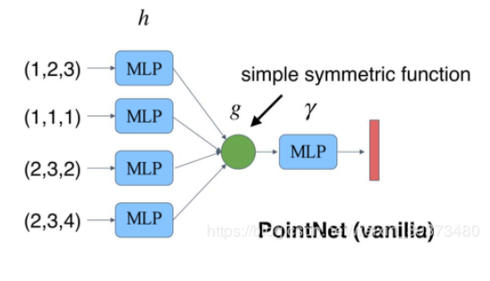
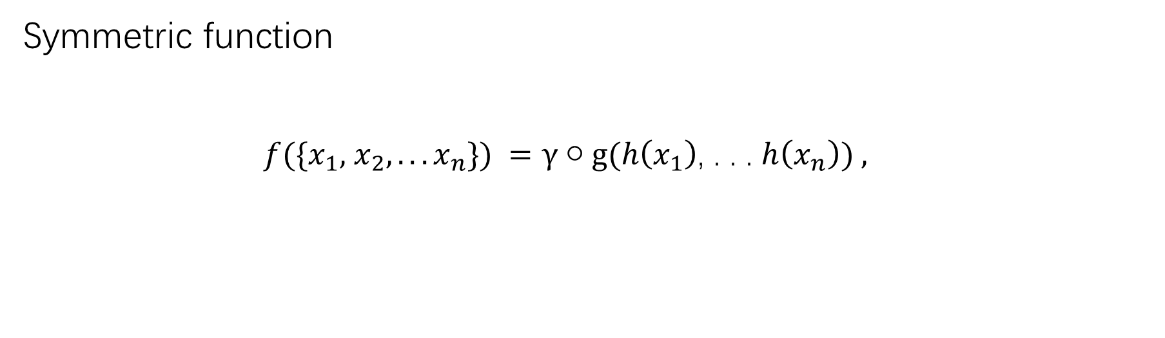
Symmetric function
$f({\{x}_{1},$ $x_{2},. . .x_{n}\}) =γ○g(h\left(x_{1}\right)$, . . . $h\left(x_{n}\right)) ,$

Slide 9
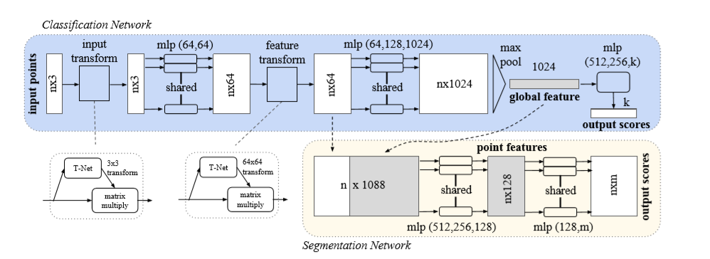
The network architecture

Slide 10
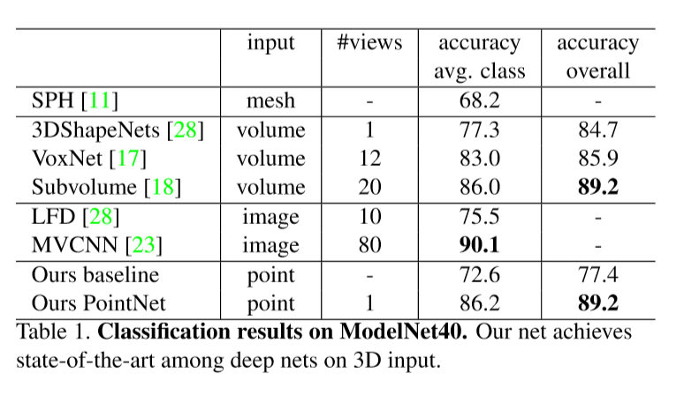
Experiment
The network learns global point cloud feature that can be used for object classification, and the authors evaluate their own model on the ModelNet40 [28]shape classifiycation benchmark.There are 12,311 CAD models from 40 man-made object categories, split into 9,843 for training and 2,468 for testing.

Slide 11
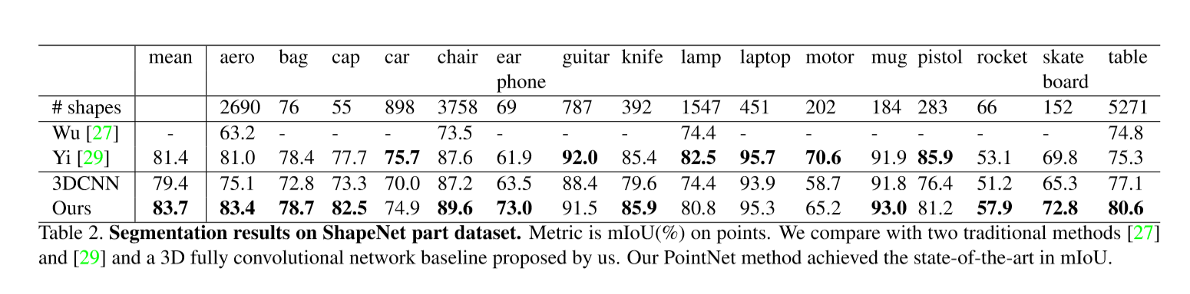
Experiment
The authors evaluate on ShapeNet part data set from [29], which contains 16,881 shapes from 16 categories, annotated with 50 parts in total.

Slide 12
Conclusion
The authors design a novel deep net architecture suitable for consuming unordered point sets in 3D and show how such a net can be trained to perform 3D shape classification, shape part segmentation, while obtaining on par or better results than state of the arts on standard benchmarks.
References
[28] Z. Wu, S. Song, A. Khosla, F. Yu, L. Zhang, X. Tang, and J. Xiao. 3d shapenets: A deep representation for volumetric shapes.
[29] A scalable active framework for region annotation in 3d shape collections.

Slide 13
THANK
YOU

